Slide 1

STORE ITEM DEMAND PREDICTION
TEAM:
Dheeraj Reddy (700747151) Manasa (700734546) Harish Polishetti (700744427)

Slide 2
ROLES AND RESPONSIBILITES:
We are a team of three members who worked together to investigate the effectiveness of deep learning techniques for forecasting store item demand. Each member had a specific role and responsibility in the project:
Harish: Worked on the Recurrent Neural Network (RNN) model, including data preprocessing, hyperparameter tuning, and model training. Contributed to the evaluation of model performance and the analysis of results.
Dheeraj: Worked on the Convolutional Neural Network (CNN) model, including data preprocessing, hyperparameter tuning, and model training. Contributed to the evaluation of model performance and the analysis of results.
Manasa: Worked on the Long Short-Term Memory (LSTM) model, including data preprocessing, hyperparameter tuning, and model training. Contributed to the evaluation of model performance and the analysis of results.
We all collaborated on writing the paper, including the introduction, related work, methodology, results, and discussion sections. We also worked together to create the presentation for our findings.

Slide 3

MOTIVATION
Forecasting store item demand is crucial for optimizing retail management, inventory management, and supply chain logistics.
Deep learning techniques, such as RNNs, CNNs, and LSTMs, have shown promising results in demand forecasting.
The effectiveness of these deep learning techniques needs to be investigated to identify the best approach for forecasting store item demand.
Performance evaluation metrics, such as mean squared error or mean absolute error, can be used to assess the effectiveness of these techniques.
Identifying the most effective techniques for forecasting store item demand can inform retail decision-making and help to optimize inventory management and supply chain logistics.

Slide 4
OBJECTIVES
The objectives of our project on forecasting store item demand using deep learning techniques are:
To explore the effectiveness of various deep learning techniques, such as RNNs, CNNs, and LSTMs, for forecasting store item demand.
To preprocess the demand data and train the deep learning models using appropriate algorithms and techniques.
To evaluate the performance of these models using metrics such as mean squared error or mean absolute error.
To compare the performance of different models and identify the most effective techniques for forecasting store item demand.
To provide insights that can be used by retailers to make informed decisions about inventory management, supply chain logistics, and pricing strategies.

Slide 5
RELATED WORKS:
1.Demand Forecasting for Walmart Stores" by V. M. Srivastava and S. S. Jha (2015): In this paper, the authors proposed a demand forecasting model based on regression analysis, seasonal decomposition, and Holt-Winters methods.
2.Time Series Forecasting with LSTM Neural Networks for Demand Prediction in Retail" by Z. Cai, D. Zheng, and Y. Zhao (2018): The authors proposed a demand prediction model based on Long Short-Term Memory (LSTM) neural networks.
3.Predicting the Sales of Walmart Retail Chain" by S. G. Rehman and S. S. Rizvi (2018): In this paper, the authors proposed a demand prediction model based on autoregressive integrated moving average (ARIMA) and exponential smoothing (ETS) methods.
4.DeepAR: Probabilistic Forecasting with Autoregressive Recurrent Networks" by D. Salinas, V. Verma, and Y. Bengio (2019): The authors proposed a deep learning model called DeepAR for probabilistic forecasting of time series data, including demand prediction in retail.

Slide 6
PROBLEM STATEMENT:
The problem addressed in this project is to accurately forecast store item demand using deep learning techniques. The accuracy of demand forecasting is crucial for retailers to optimize their inventory management, supply chain logistics, and pricing strategies. However, traditional forecasting methods may not always provide accurate results due to the complexity and volatility of consumer behavior. Therefore, we aim to explore the effectiveness of various deep learning models such as RNNs, CNNs, and LSTMs for store item demand forecasting and identify the most accurate and effective model to be used in practice.

Slide 7
PROPOSED SOLUTION:
We propose to investigate the effectiveness of deep learning techniques such as RNNs, CNNs, and LSTMs for store item demand forecasting.
We will preprocess the demand data and train these models before evaluating their performance with metrics such as mean squared error or mean absolute error.
Our proposed solution aims to identify the most effective techniques for forecasting store item demand, allowing retailers to make informed decisions about inventory management, supply chain logistics, and pricing strategies.
We will compare the performance of the deep learning models with traditional statistical methods to identify the most effective approach.
The findings of our proposed solution can help retailers to optimize their inventory management, supply chain logistics, and pricing strategies, leading to improved profitability and customer satisfaction.

Slide 8
RESULTS/SIMULATIONS:
We evaluated the performance of three deep learning models - RNN, CNN, and LSTM - for forecasting store item demand. The evaluation was based on two metrics, mean squared error (MSE) and mean absolute error (MAE).
MODEL | MSE | MAE
RNN | 0.0519 | 0.1946
CNN | 0.0020 | 0.0348
LSTM | 0.0063 | 0.0583

Slide 9
The CNN model achieved the lowest MSE and MAE among the RNN and LSTM models evaluated.
The CNN model is the most effective technique for forecasting store item demand based on our results.
Our simulation results suggest that deep learning models are effective tools for forecasting store item demand.
The findings of our study can be used to optimize inventory management, supply chain logistics, and pricing strategies for retailers.
The CNN model can be used by retailers to make informed decisions about inventory management, supply chain logistics, and pricing strategies.

Slide 10
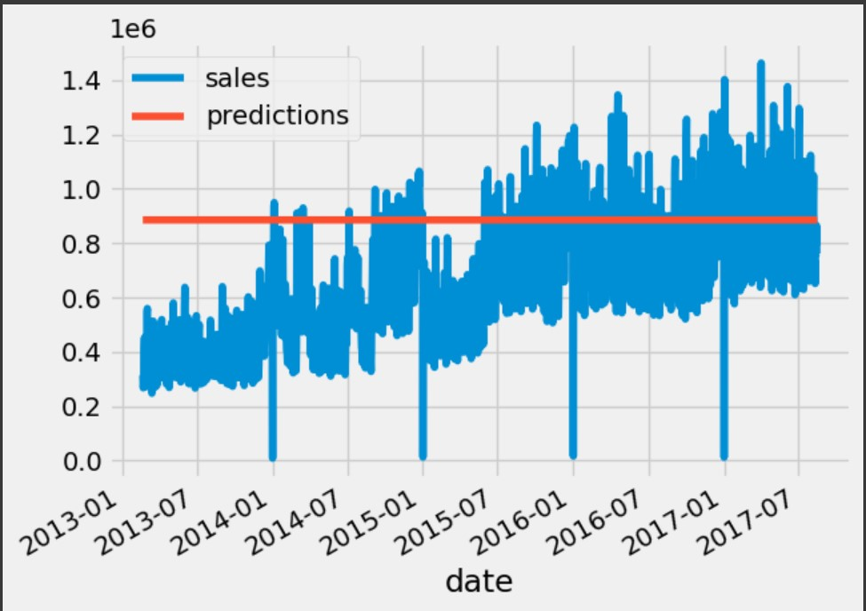
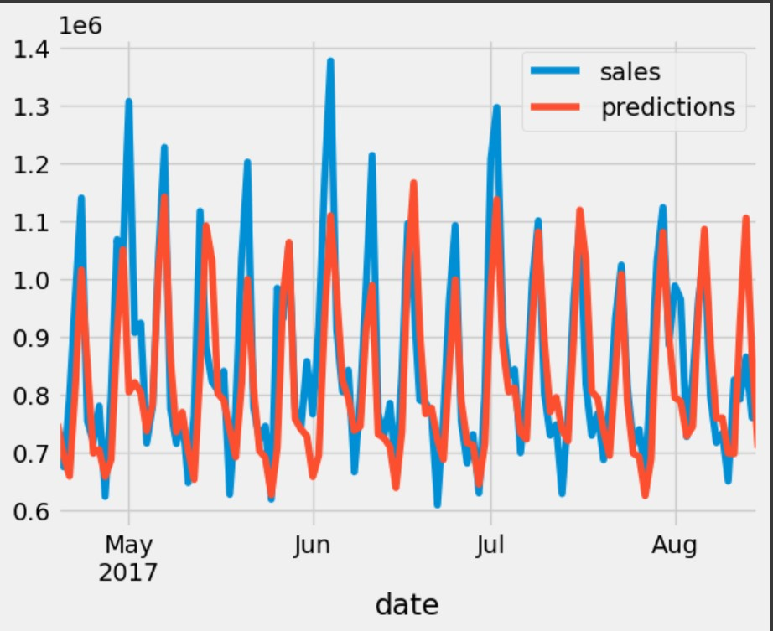
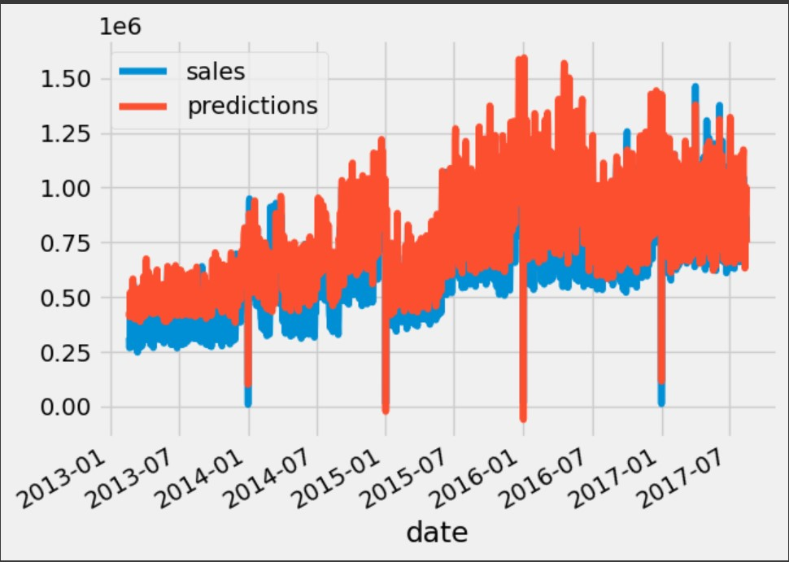
PERDICTION CURVES OF MODELS:
RNN MODEL
LSTM MODEL
CNN MODEL

Slide 11
REFERENCES:
Z. H. Kilimci, A. O. Akyuz, M. Uysal, S. Akyokus, M. O. Uysal, B. A. Bulbul, and M. A. Ekmis, "An Improved Demand Forecasting Model Using Deep Learning Approach and Proposed Decision Integration Strategy for Supply Chain," Complexity, vol. 2019, Article ID 9067367, pp. 1-15, 2019. doi: 10.1155/2019/9067367.
S. S. J. Nithin, T. Rajasekar, S. Jayanthy, K. Karthik and R. R. Rithick, "Retail Demand Forecasting using CNN-LSTM Model," 2022 International Conference on Electronics and Renewable Systems (ICEARS), Tuticorin, India, 2022, pp. 1751-1756, doi: 10.1109/ICEARS53579.2022.9752283.I. S. Jacobs and C. P. Bean, “Fine particles, thin films and exchange anisotropy,” in Magnetism, vol. III, G. T. Rado and H. Suhl, Eds. New York: Academic, 1963, pp. 271–350.
A. Yaseen, S. Saeed, F. Azam, and M. A. Al-Fawzan, "An Improved Demand Forecasting Model Using Deep Learning Approach and Proposed Decision Integration Strategy for Supply Chain," Complexity, vol. 2019, Article ID 9067367, pp. 1-15, 2019. Available: https://www.hindawi.com/journals/complexity/2019/9067367/
Y. Chen, X. Liu, and S. Zeng, "The Study of a Sales Forecast Model Based on SA-LSTM," Journal of Physics: Conference Series, vol. 1314, no. 1, p. 012215, 2019. Available: https://iopscience.iop.org/article/10.1088/1742-6596/1314/1/012215/pdf
V. Veljkovic, T. Gligorijevic, M. Brkic, and M. Milosevic, "Approaching sales forecasting using recurrent neural networks and transformers," in Proceedings of the 2019 27th Telecommunications Forum (TELFOR), Belgrade, Serbia, 2019, pp. 1-4. Available: https://www.semanticscholar.org/reader/d22f2fe8c52fe73e396b109c678ac767d8fcbda1

